Slide 1



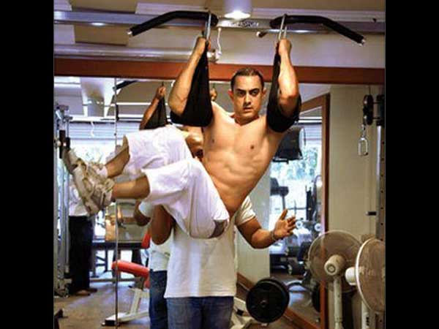
Gym Management System

Slide 2

ABC University
Guided By: Presented By:
Mr . XYZ Sir AAAAAAA BBBBBBB

Slide 3

DEVELOPER
AAAAAAAAAA (111CSE111111)
BBBBBBBBBB (222CSE222222)

Slide 4
ABSTRACT
OBJECTIVE:
This Gym Management project deals with an online system designed for management of customers , enquiries , equipments and payment.
The current system is manual and it is time-consuming. It is also cost-ineffective, and the average return is low and diminishing
This software helps to easy management of gym such as management of customers , equipments, plans , enquiries etc.

Slide 5
ADMIN MODULES
Manage Plans
Manage Registration
Manage Equipment
Manage Customer Enquiry

Slide 6
1. Administrative module
Administrative module is provided for the sake of administrators to manage the software and update the content at regular intervals, The major operations included in this module are:
Manage plans, Registration, Equipment, Enquiry.

Slide 7
2. Plan Module
Plan module show different plans.
Plan module also include the price and duration of the plan.

Slide 8
3. Equipment module
This module is meant Adding and Replacing of machines or equipments.

Slide 9
4. Customer Enquiry
This module is meant for managing customers enquiry details.

Slide 10
PURPOSE
The purpose of this project is to provide online way to manage the gym , and also provide a easy interface for management.

Slide 11
SCOPE
The project has a wide scope, as it is not intended to a particular organization. This project is going to develop generic software, which can be applied by any businesses organization. More over it provides facility to its customer. Also the software is going to provide a huge amount of summary data.

Slide 12
PROPOSED SYSTEM:
The Gym Management system is available in the market that can serve gym owners to easily manage our gym from anywhere at anytime.

Slide 13
Hardware and Software Specification
Software Requirements:
Operating System: Windows 7/8/10, Linux etc.
Xampp
Hardware Requirements:
Intel Processor 2.0 GHz or above.
2 GB RAM or more.
160 GB or more Hard Disk Drive.

Slide 14
Technology Used :
FrontEnd(Language Used) :
HTML
CSS
Javascript
BackEnd(Database Used) :
MYSQL
PHP

Slide 15
SYSTEM DESIGN
Unified Modeling Language:
UML stands for Unified Modeling Language. It is a third generation method for specifying, visualizing and documenting the artifacts of an object oriented system under development. Object modeling is the process by which the logical objects in the real world (problem space) are represented (mapped) by the actual objects in the program (logical or a mini world). This visual representation of the objects, their relationships and their structures is for the ease of understanding. This is a step while developing any product after analysis.

Slide 16
The Unified Modeling Language encompasses a number of models.
Use case diagrams
Data Flow diagrams
Sequence diagrams

Slide 17
Use Case Diagram:
Use case diagram consists of use cases and actors and shows the interaction between them. The key points are:
The main purpose is to show the interaction between the use cases and the actor.
To represent the system requirement from user’s perspective.
The use cases are the functions that are to be performed in the module.
An actor could be the end-user of the system or an external system.

Slide 18
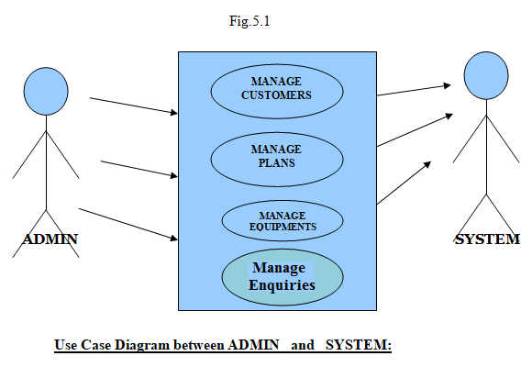

Slide 19
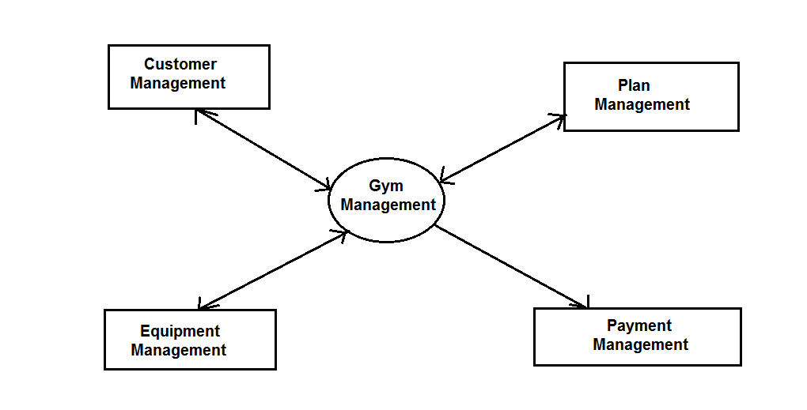
DFD(Data Flow Diagram)

Slide 20
Sequence Diagram:
The purpose of sequence diagram is to show the flow of functionality through a use case. In other words, we call it a mapping process in terms of data transfers from the actor through the corresponding objects.

Slide 21
SEQUENCE DIAGRAM

Slide 22
Sequence Diagram For Administrator:-
Login
Application
Database
Login
:Request
:Validate()
:executeQuery()
Response
Show Result
Failed:show()

Slide 23
ER DIAGRAM

Slide 24
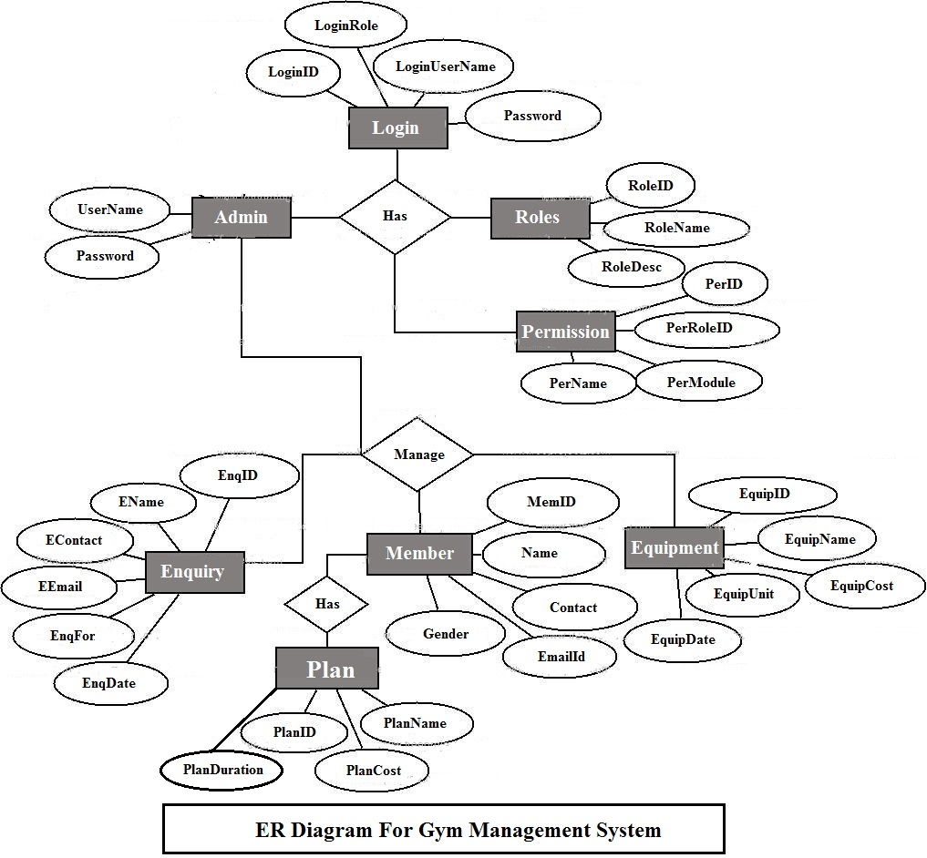

Slide 25
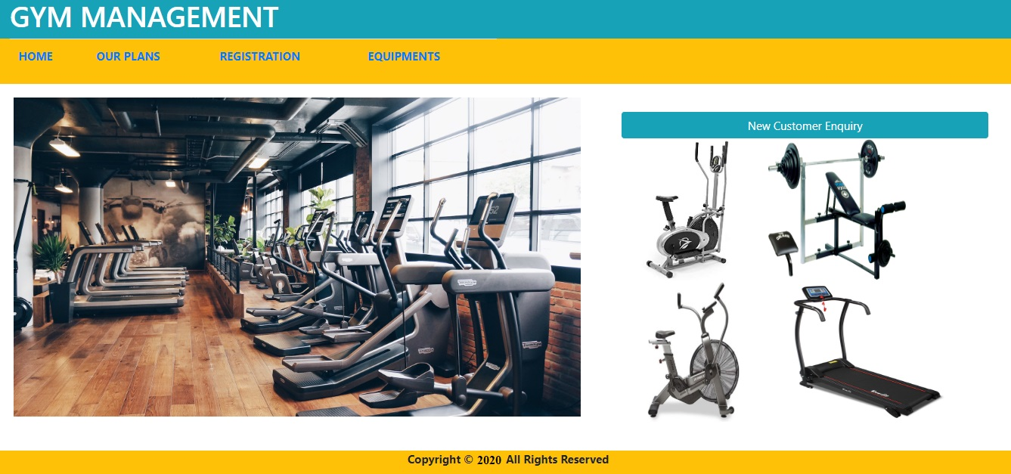
HOME PAGE

Slide 26
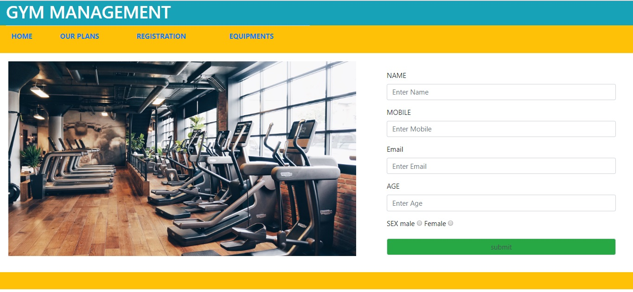
SCREEN SHOTS CUSTOMER ENQUIRY PAGE

Slide 27
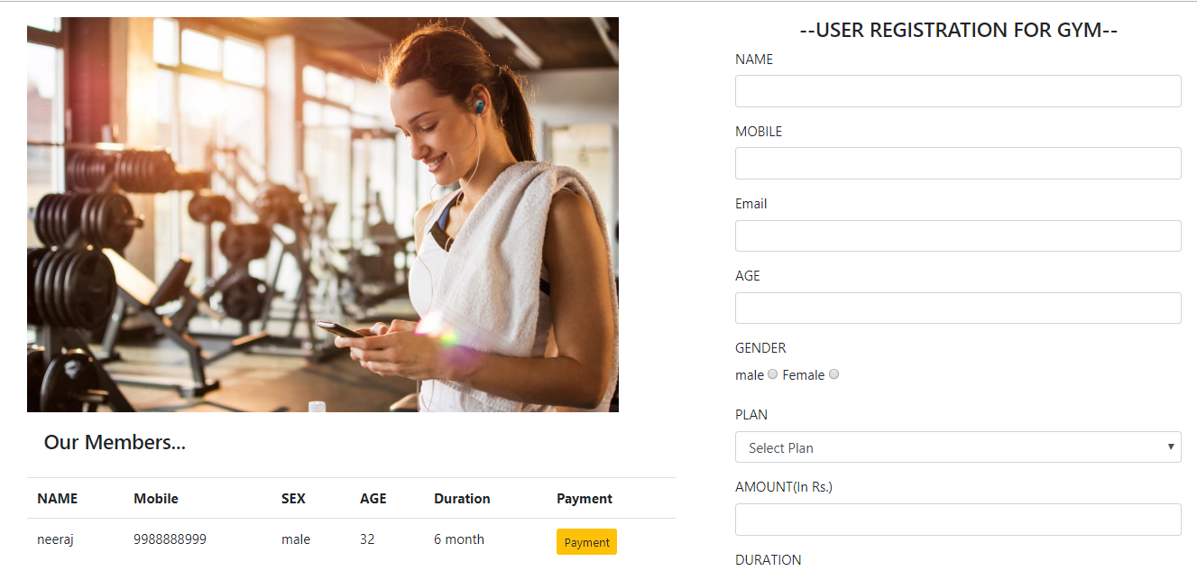
REGISTER NEW USER PAGE

Slide 28
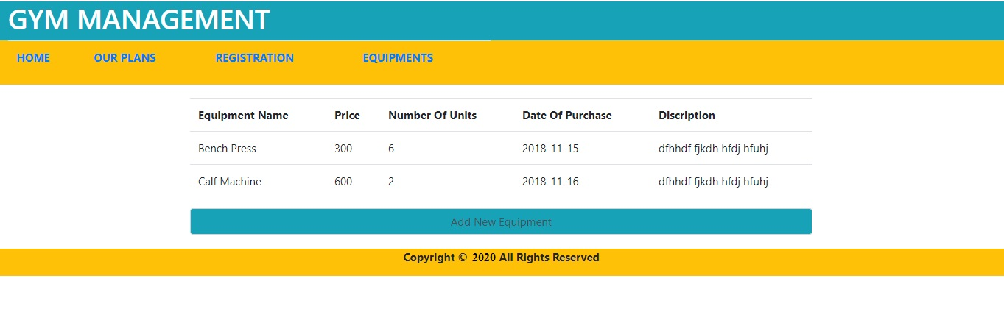
VIEW EQUIPMENT DETAIL PAGE

Slide 29
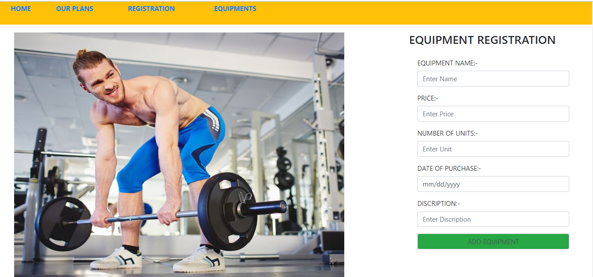
ADD EQUIPMENT DETAIL PAGE

Slide 30
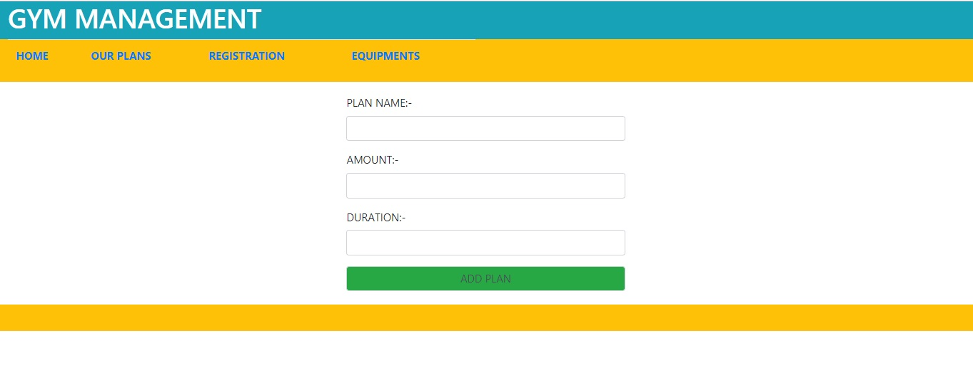
ADD NEW PLAN

Slide 31
CONCLUSION & FUTURE SCOPE
FUTURE SCOPE
This web application involves almost all the features of the online management. The future implementation will be online help for the customers and chatting with website administrator.
CONCLUSION
The project entitled “Gym Management System” is developed using HTML,CSS and JavaScript as front end and PHP , MYSQL database in back end to computerize the process of gym management. This project covers only the basic features required.

Slide 32
BIBLIOGRAPHY
FOR PHP INSTALLATION
www.php.net
FOR DEPLOYMENT AND PACKING ON SERVER
www.developer.com
www.15seconds.com
FOR MYSQL
www.mysql.com
FOR PHP,CSS,APACHE
www.w3schools.com
www.php.net
www.javatpoint.com
www.apache.org

Slide 33
THANKYOU

